Slide 1
Neural correlates of the LSD experience revealed by multimodal neuroimaging
(Carhart-Harris et al., 2016)

Slide 2
Overview
Introduction and background
Research question
Methods
Results
Discussion and conclusion
Summary

Slide 3
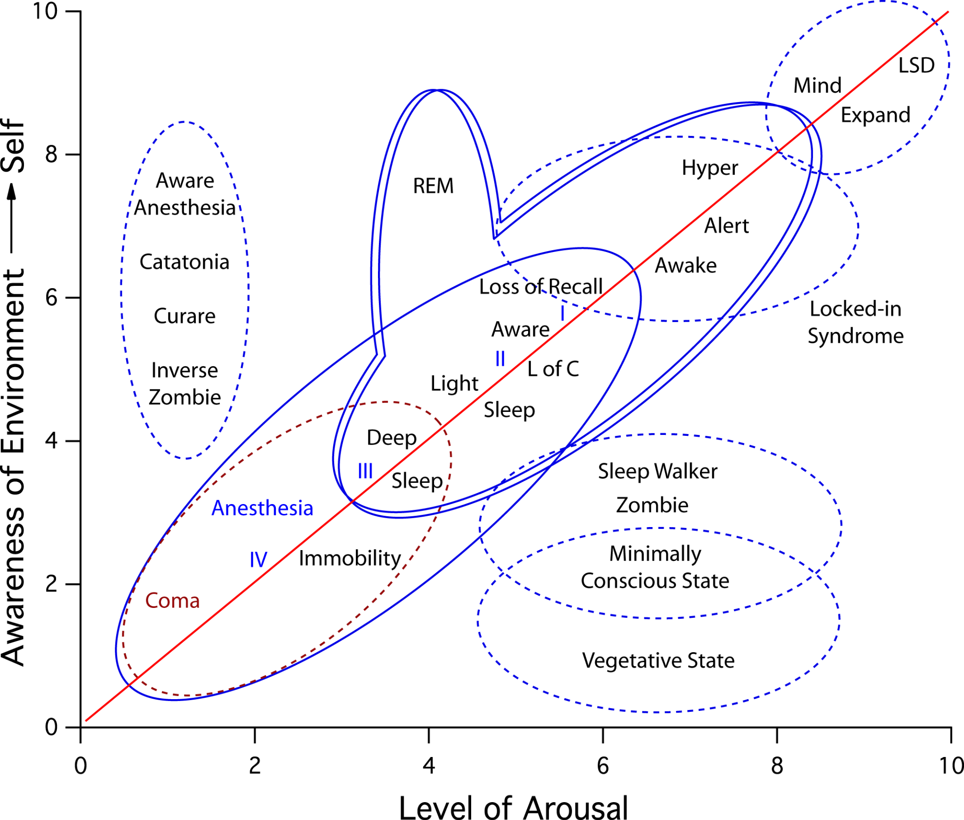

Slide 4
Introduction
LSD
Prototypical psychedelic drug
Alters consciousness in a profound, “life changing” way
High affinity for for serotonin neurotransmitters
Previous studies only observed the effects using EEG and fMRI data on rodents
Notes:
Prototypical due to its historical significance, the discovery of the drug marked the beginning of modern psychedelic research and the exploration of altered states of consciousness.
(seratonin 2A receptor, linked to profound sensory and cognitive changes)
EEG measuring electrical activity on the scalp

Slide 5
Background
Studies examined effects of psilocybin and MDMA
Reported decreased cerebral blood flow (CBF) and decreased resting state functional connectivity (RSFC) in major resting state networks (RSNs)
Most notably on default mode network (DMN) - associated with wakeful rest, daydreaming, thinking of self (and others) and detailed thoughts
Findings suggested an “entropic effect” as a key characteristic of the psychedelic state - displaying novel patterns of communication within the brain
Notes:
RSFC measures the temporal correlation of blood oxygenated RSNs are
Explain entropic effect

Slide 6
Research question
First peak at the drug’s effect on human brain activity along with evidence for potential therapeutic and scientific value using modern neuroimaging techniques
Hypothesized that major RSNs and hippocampal activity would be involved in drugs characteristic mechanism

Slide 7
Methods
Placebo controlled design
Three neuroimaging techniques: ASL, BOLD and MEG
Twenty participants attending two scanning days (LSD and placebo)
Resting state conditions (eyes closed) during the experience
ASL scans 100 min, BOLD 135 min (peak) and MEG 225 min after IV administration of the drug (placebo)
Participants completed an altered states of consciousness questionnaire (measuring spiritual experience, disembodiment, complex imagery etc. )
Notes:
Explain ASL BOLD AND MEG

Slide 8
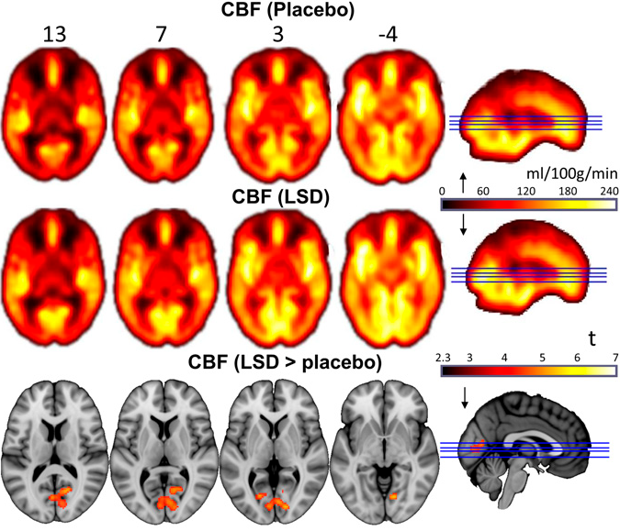
Results
Greater CBF in the visual cortex, significantly correlating with ratings of complex hallucinations

Slide 9
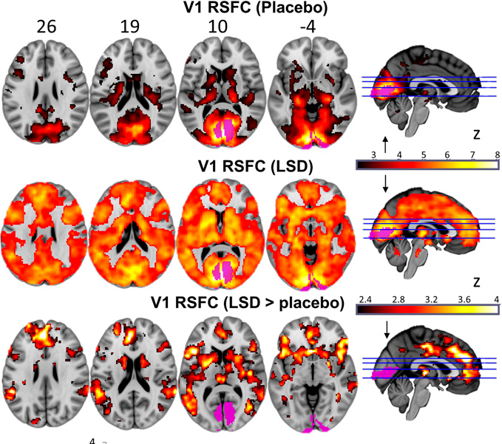
Results - BOLD scans
Increased RSFC between V1 and cortical brain regions, significantly correlating with simple and elementary hallucinations along with complex imagery.

Slide 10
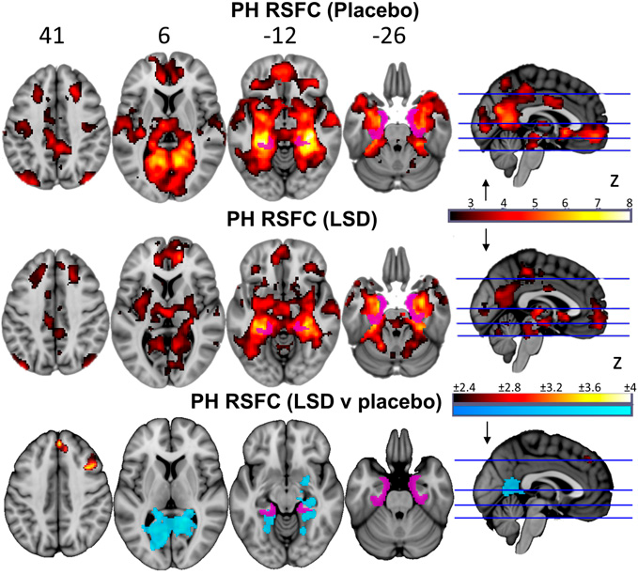
Results - BOLD scans
Decrease in RSFC between parahippocampal gyrus and retrosplenial cortex, significantly correlating with ratings on ego-dissolution and altered meaning

Slide 11
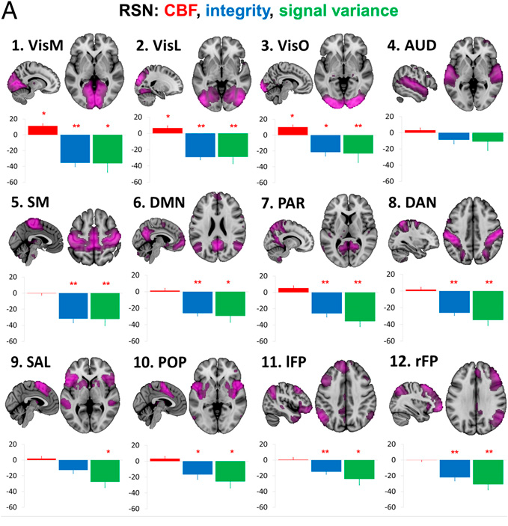
Results
Examined effects of LSD on twelve RSN properties
Four metrics chosen: within RSN CBF, within RSN RSFC (“integrity”), within RSN BOLD signal variance and between RSN RSFC (“segregation”)

Slide 12
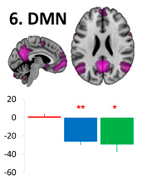
Results
Confirmed predicted hypothesis of decreased DMN “integrity” - correlating with ego dissolution (calculated correlations for other RSNs to check selectivity and none were significant)

Slide 13
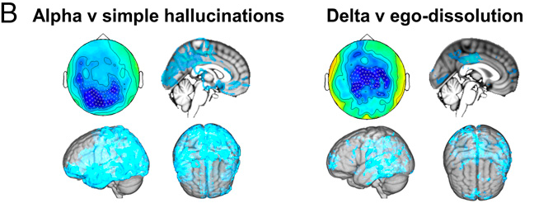
Results
Decreased alpha power correlated with visual hallucinations, along with decrease in delta waves correlating with profound changes in consciousness
Notes:
Explain the lower frequency bands

Slide 14
Discussion - Visual Hallucinations
Reinforce the view that neuroimaging techniques can be used to inform on neural correlates of psychedelic state:
Increase in V1 RSFC correlated with decreased alpha power, suggesting a far greater proportion of the brain contributing to visual processing under LSD
“Seeing with eyes shut” suggested by instability of primary visual cortex
Neurobiology of psychedelic induced visual state informs on mechanisms of visual processing
Notes:
1. Found strong relationships between BOLD RSFC changes and changes in oscillatory power, enabling inferences of their function
2. So called “coloring” of the normally discreet psychological functions such as emotion, cognition and other primary senses)
3. Emergence of geometric hallucinations, via self organized patterns of neural excitation, seeing “as if” there is a visual input

Slide 15
Discussion - Altering consciousness
In a similar way, the neurobiology of psychedelically induced ego dissolution can inform on neurobiology of “self”:
Preservation of DMN integrity, PH-RSFC communication and oscillation rhythms might be important for maintaining one’s sense of self
Modulation of PH RSFC may be important for the “profound” experiences
Notes:
1. DMN disintegration and ego dissolution had a strong significant correlation
2. Intriguing to consider whether this circuit is involved in psychosis related experiences

Slide 16
Entropy
Becomes more evident that psychedelics reduce stability and integrity of the brain networks, while at the same time inducing network desegregation
In psychiatric disorders - “The brain might be viewed as being trapped in automated and rigid behaviors, psychedelics may work to break down (disorders) by dismantling patterns of activity upon which they rest”

Slide 17
QUESTIONS

